Slide 1
Chocolate Business Report
Sales Analysis Dashboard | Power BI | Trend & Performance Overview

Slide 2
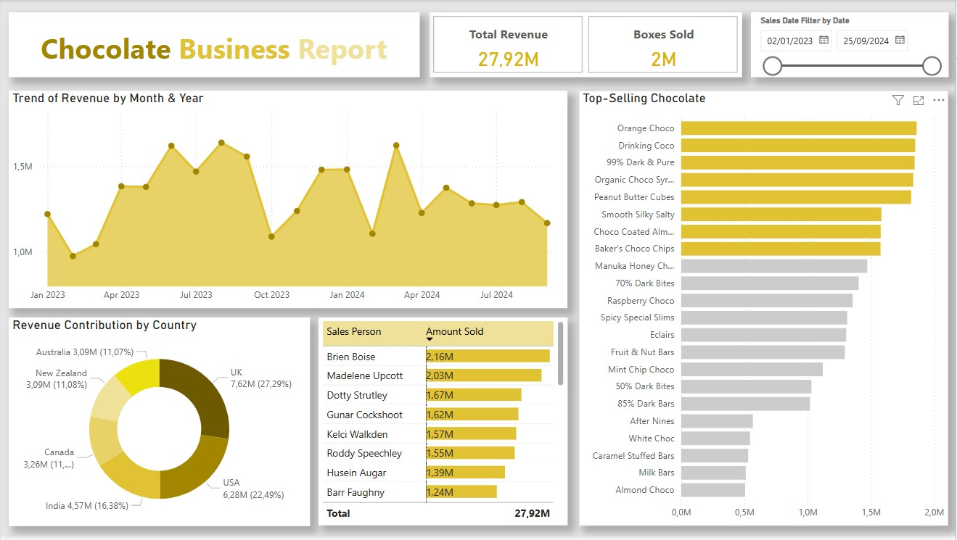
Chocolate Business Sales Dashboard
A comprehensive overview of chocolate sales performance from Jan 2023 to Sep 2024. This dashboard captures key insights across trends, product performance, country contributions, and sales team effectiveness.

Slide 3

Total Revenue & Boxes Sold
Total Revenue: €27.92 million
Total Boxes Sold: 2 million
Date Range: February 1, 2023 – September 25, 2024
The business has demonstrated consistent performance with seasonal revenue peaks.

Slide 4
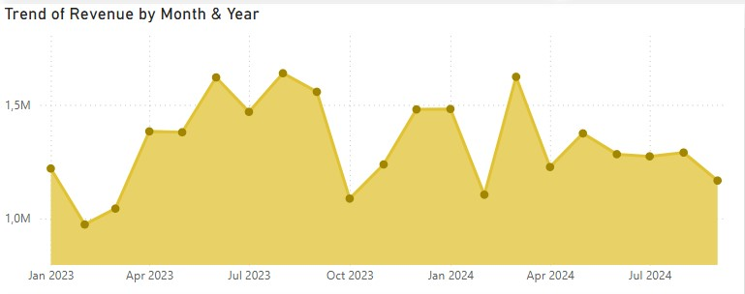
Trend of Revenue by Month & Year
Revenue Peaks: July 2023 and March 2024 saw the highest sales.
Low Points: Notable dip in revenue during October 2023 and February 2024.
Pattern: Revenue fluctuates monthly, indicating potential seasonality or promotional cycles.

Slide 5
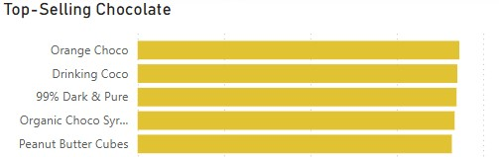
Top-Selling Chocolates
Leading products: Orange Choco, Drinking Coco, 99% Dark & Pure, and Peanut Butter Cubes.
Each sold close to 2M units, showing strong consumer preference. Focus on retaining these products and exploring new variants based on their taste profiles.

Slide 6
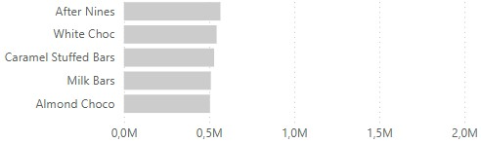
Low-Selling Chocolates
Products like Almond Choco, Milk Bars, and Caramel Stuffed Bars performed poorly (<0.5M).
These may need redesign, marketing boosts, or discontinuation. Identifying reasons behind poor sales can help improve overall product portfolio performance.

Slide 7
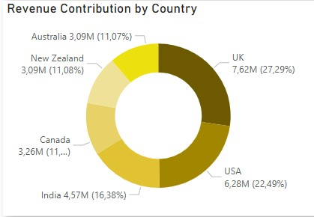
Revenue by Country
Geographic Revenue Contribution
UK leads with €7.62M (27.29%), followed by USA and India.
Canada, Australia, and New Zealand contribute equally (~11%). Growth potential exists in mid-tier markets through targeted campaigns and regional promotions.

Slide 8
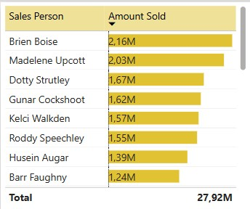
Salesperson Performance
Top Sales Performers
Brien Boise and Madelene Upcott led with over €2M in sales.
Strong mid-tier performers present in the 1.5M–1.7M range. Use this data to design incentive programs and replicate high-performer strategies across the team
Observation: Top 5 salespeople contribute a significant portion of overall sales—consider incentives or leadership roles.

Slide 9
Recommendations
Marketing Focus:
Target UK and India with top products.
Run seasonal promotions aligned with peak sales months.
Product Strategy:
Promote top 5 chocolate types via bundles or ads.
Consider reducing focus on lower-performing items.
Sales Strategy:
Leverage best-performing sales staff for mentorship/training.
Recognize and reward top sellers to maintain motivation.

Slide 10
Thank You

